Slide 1
Able to develop the real time scenarios based on Node JS applications
Notes:
Title - The learning outcome
Subtitle - Duration

Slide 2
In this section, we will discuss:
Create Web App using express
Introduction Middleware Concepts
Express Routing
Express JS Template Engine
Handling Query string parameter
Cookies parser & body parser,
Session Handling (express session), Mailer
Database operation with MySQL
Notes:
Mention the parent topics one by one. This particular learning outcome has 4 parent topics.

Slide 3
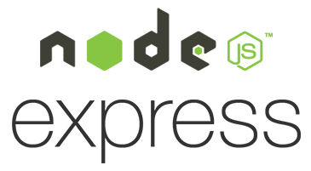
Create Web App using express
Express Overview
Express is a minimal and flexible Node.js web application framework that provides a robust set of features to develop web and mobile applications.
It facilitates the rapid development of Node based Web applications.
Image Source: https://medium.com/@ralph1786/how-to-setup-an-express-server-5fd9cd9ae073
Notes:
Left (White Color space):
Title - Parent Topic
Subtitle - Subtopic 1
Body Text - Description in bullets
Right (Grey Color Space):
Body Text - Relevant image (with source)/code snippet
Put reference links in Speaker Notes
Reference:
https://www.tutorialspoint.com/internet_technologies/internet_overview.htm/

Slide 4
Create Web App using express
Core features of Express framework
Allows to set up middlewares to respond to HTTP Requests.
Defines a routing table which is used to perform different actions based on HTTP Method and URL.
Allows to dynamically render HTML Pages based on passing arguments to templates.
Image Source: https://medium.com/@ralph1786/how-to-setup-an-express-server-5fd9cd9ae073
Notes:
Left (White Color space):
Title - Parent Topic
Subtitle - Subtopic 1
Body Text - Description in bullets
Right (Grey Color Space):
Body Text - Relevant image (with source)/code snippet
Put reference links in Speaker Notes
Reference:
https://www.tutorialspoint.com/internet_technologies/internet_overview.htm/

Slide 5
Create Web App using express
Installing Express
$ npm install express –save
The above command saves the installation locally in the node_modules directory and creates a directory express inside node_modules.
Image Source: https://medium.com/@ralph1786/how-to-setup-an-express-server-5fd9cd9ae073
Notes:
Left (White Color space):
Title - Parent Topic
Subtitle - Subtopic 1
Body Text - Description in bullets
Right (Grey Color Space):
Body Text - Relevant image (with source)/code snippet
Put reference links in Speaker Notes
Reference:
https://www.tutorialspoint.com/internet_technologies/internet_overview.htm/

Slide 6
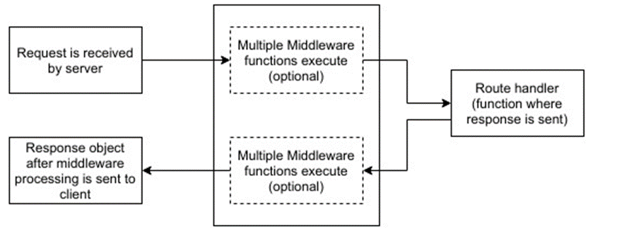
Introduction to Middleware Concepts
ExpressJS – Middleware
Middleware functions are functions that have access to the request object (req), the response object (res), and the next middleware function in the application’s request-response cycle.
These functions are used to modify req and res objects for tasks like parsing request bodies, adding response headers, etc.
Image Source: https://www.tutorialspoint.com/expressjs/expressjs_middleware.htm
Notes:
Left (White Color space):
Title - Parent Topic
Subtitle - Subtopic 1
Body Text - Description in bullets
Right (Grey Color Space):
Body Text - Relevant image (with source)/code snippet
Put reference links in Speaker Notes
Reference:
https://www.tutorialspoint.com/internet_technologies/internet_overview.htm/

Slide 7
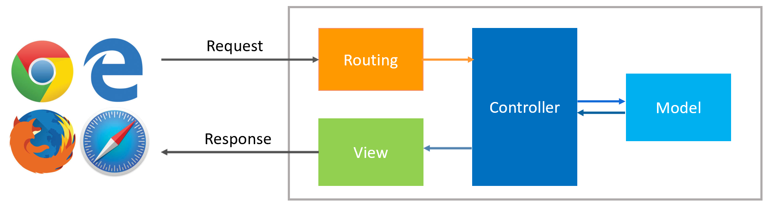
Express Routing
ExpressJS – Routing
Web frameworks provide resources such as HTML pages, scripts, images, etc. at different routes.
The following function is used to define routes in an Express application −
app.method(path, handler)
Image Source: https://www.dotnettricks.com/learn/nodejs/expressjs-routes-routing
Notes:
Left (White Color space):
Title - Parent Topic
Subtitle - Subtopic 1
Body Text - Description in bullets
Right (Grey Color Space):
Body Text - Relevant image (with source)/code snippet
Put reference links in Speaker Notes
Reference:
https://www.tutorialspoint.com/internet_technologies/internet_overview.htm/

Slide 8
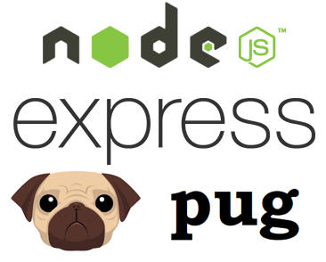
Express JS Template Engine
ExpressJS – Templating
Pug is a templating engine for Express.
Templating engines are used to remove the cluttering of our server code with HTML, concatenating strings wildly to existing HTML templates.
Image Source: https://medium.com/@carmelagreco/quick-generation-of-a-new-node-js-project-using-express-express-generator-and-pug-f8e9cf6b2687
Notes:
Left (White Color space):
Title - Parent Topic
Subtitle - Subtopic 1
Body Text - Description in bullets
Right (Grey Color Space):
Body Text - Relevant image (with source)/code snippet
Put reference links in Speaker Notes
Reference:
https://www.tutorialspoint.com/internet_technologies/internet_overview.htm/

Slide 9
Express JS Template Engine
ExpressJS – Templating
To use Pug with Express, we need to install it,
npm install --save pug
Now that Pug is installed, set it as the templating engine for your app.
Image Source: https://medium.com/@carmelagreco/quick-generation-of-a-new-node-js-project-using-express-express-generator-and-pug-f8e9cf6b2687
Notes:
Left (White Color space):
Title - Parent Topic
Subtitle - Subtopic 1
Body Text - Description in bullets
Right (Grey Color Space):
Body Text - Relevant image (with source)/code snippet
Put reference links in Speaker Notes
Reference:
https://www.tutorialspoint.com/internet_technologies/internet_overview.htm/

Slide 10
Express JS Template Engine
ExpressJS – Templating
Important Features of Pug
Simple Tags
Space separated
Piped text
Block of text
Image Source: https://medium.com/@carmelagreco/quick-generation-of-a-new-node-js-project-using-express-express-generator-and-pug-f8e9cf6b2687
Notes:
Left (White Color space):
Title - Parent Topic
Subtitle - Subtopic 1
Body Text - Description in bullets
Right (Grey Color Space):
Body Text - Relevant image (with source)/code snippet
Put reference links in Speaker Notes
Reference:
https://www.tutorialspoint.com/internet_technologies/internet_overview.htm/

Slide 11
Handling Query string parameter
ExpressJS – URL Building
We can now define routes, but those are static or fixed. To use the dynamic routes, we SHOULD provide different types of routes.
Using dynamic routes allows us to pass parameters and process based on them.
Image Source: https://medium.com/@ralph1786/how-to-setup-an-express-server-5fd9cd9ae073
Notes:
Left (White Color space):
Title - Parent Topic
Subtitle - Subtopic 1
Body Text - Description in bullets
Right (Grey Color Space):
Body Text - Relevant image (with source)/code snippet
Put reference links in Speaker Notes
Reference:
https://www.tutorialspoint.com/internet_technologies/internet_overview.htm/

Slide 12

Cookies parser & body parser
ExpressJS – Cookies
Cookies are simple, small files/data that are sent to client with a server request and stored on the client side.
Every time the user loads the website back, this cookie is sent with the request.
This helps us keep track of the user’s actions.
Image Source: https://www.w3jar.com/node-express-js-cookies/
Notes:
Left (White Color space):
Title - Parent Topic
Subtitle - Subtopic 1
Body Text - Description in bullets
Right (Grey Color Space):
Body Text - Relevant image (with source)/code snippet
Put reference links in Speaker Notes
Reference:
https://www.tutorialspoint.com/internet_technologies/internet_overview.htm/

Slide 13
Cookies parser & body parser
ExpressJS – Cookies
The following are the numerous uses of the HTTP Cookies −
Session management
Personalization(Recommendation systems)
User tracking
Image Source: https://www.w3jar.com/node-express-js-cookies/
Notes:
Left (White Color space):
Title - Parent Topic
Subtitle - Subtopic 1
Body Text - Description in bullets
Right (Grey Color Space):
Body Text - Relevant image (with source)/code snippet
Put reference links in Speaker Notes
Reference:
https://www.tutorialspoint.com/internet_technologies/internet_overview.htm/

Slide 14
Cookies parser & body parser
ExpressJS – Body-parser
Body-parser is the Node.js body parsing middleware.
It is responsible for parsing the incoming request bodies in a middleware before you handle it.
Image Source: https://medium.com/@ralph1786/how-to-setup-an-express-server-5fd9cd9ae073
Notes:
Left (White Color space):
Title - Parent Topic
Subtitle - Subtopic 1
Body Text - Description in bullets
Right (Grey Color Space):
Body Text - Relevant image (with source)/code snippet
Put reference links in Speaker Notes
Reference:
https://www.tutorialspoint.com/internet_technologies/internet_overview.htm/

Slide 15
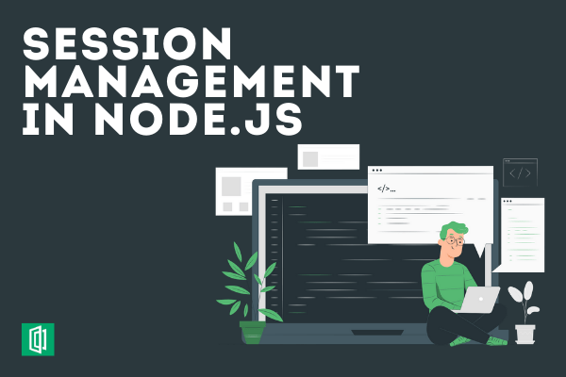
Session Handling (express session), Mailer
ExpressJS – Sessions
Sessions assign the client an ID and it makes all further requests using that ID.
Information associated with the client is stored on the server linked to this ID.
Image Source: https://www.section.io/engineering-education/session-management-in-nodejs-using-expressjs-and-express-session/
Notes:
Left (White Color space):
Title - Parent Topic
Subtitle - Subtopic 1
Body Text - Description in bullets
Right (Grey Color Space):
Body Text - Relevant image (with source)/code snippet
Put reference links in Speaker Notes
Reference:
https://www.tutorialspoint.com/internet_technologies/internet_overview.htm/

Slide 16
Session Handling (express session), Mailer
ExpressJS – mailer
Express Mailer extends your express application
Works with Express 3.x.x
Install by the following command:
$ npm install express-mailer
Image Source: https://medium.com/@ralph1786/how-to-setup-an-express-server-5fd9cd9ae073
Notes:
Left (White Color space):
Title - Parent Topic
Subtitle - Subtopic 1
Body Text - Description in bullets
Right (Grey Color Space):
Body Text - Relevant image (with source)/code snippet
Put reference links in Speaker Notes
Reference:
https://www.tutorialspoint.com/internet_technologies/internet_overview.htm/

Slide 17
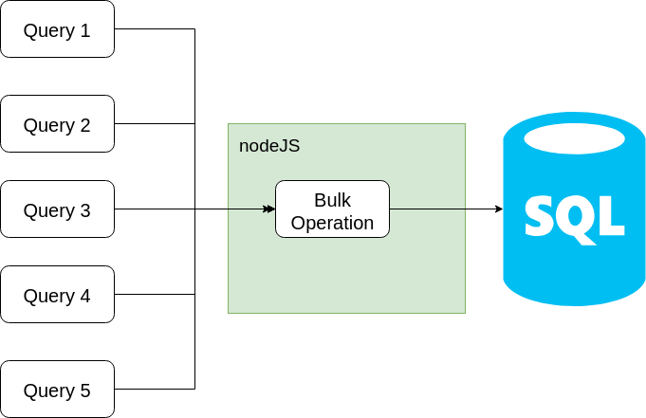
Database operation with MySQL
Setup Express js for Node.js MySQL
To set up express, we will use the express-generator.
You can generate an express js app without any view engine with the following command:
npx express-generator --no-view --git nodejs-mysql
Image Source: https://levelup.gitconnected.com/bulk-operation-into-mysql-with-nodejs-478c8fc30917
Notes:
Left (White Color space):
Title - Parent Topic
Subtitle - Subtopic 1
Body Text - Description in bullets
Right (Grey Color Space):
Body Text - Relevant image (with source)/code snippet
Put reference links in Speaker Notes
Reference:
https://www.tutorialspoint.com/internet_technologies/internet_overview.htm/

Slide 18
Database operation with MySQL
MySQL Installation
The following command will install MySQL
$ npm install mysql
Image Source: https://levelup.gitconnected.com/bulk-operation-into-mysql-with-nodejs-478c8fc30917
Notes:
Left (White Color space):
Title - Parent Topic
Subtitle - Subtopic 1
Body Text - Description in bullets
Right (Grey Color Space):
Body Text - Relevant image (with source)/code snippet
Put reference links in Speaker Notes
Reference:
https://www.tutorialspoint.com/internet_technologies/internet_overview.htm/

